Slide 1
METH 2.0 | The New Meth
There’s a new methamphetamine hitting our communities
Notes:
Welcome to today’s presentation to discuss Methamphetamine.
Meth has evolved over the years, many facts on meth are now different, so it is important for us to take a first-hand look at the magnitude of this problem in our community and learn about the New Meth.

Slide 2
What is
meth?
How big is the problem?
What can you do?
Notes:
Today, we will talk about three aspects of this issue … CLICK
First, we’ll discuss what methamphetamine is. CLICK
Next, we’ll talk about how big this problem is and what’s driving it. CLICK
Finally, we’ll talk about what we can do as family and community members to help stop this serious problem.

Slide 3
Methamphetamine is
A powerful, highly addictive stimulant that affects the central nervous system.
Is it the same as amphetamines?
No, but it is chemically similar to amphetamine, a prescription stimulant that increases specific types of brain activity.
Common
Street Names
Blue
Crystal
Ice
Meth
Speed
Emojis
Drug dealers often use emojis to depict meth for sale.
Notes:
Let’s take a closer look at what is methamphetamine.
Methamphetamine is a powerful, highly addictive stimulant drug that affects the central nervous system. The drug’s ability to rapidly release high levels of dopamine in reward areas of the brain creates physical and psychological dependence and can lead to a substance use disorder. CLICK
It is chemically similar to amphetamine, a prescription stimulant that increases specific types of brain activity. CLICK
Common street names include blue, crystal, ice, meth, and speed. CLICK
People who sell drugs often use emojis to advertise meth for sale on social media sites. CLICK

Slide 4
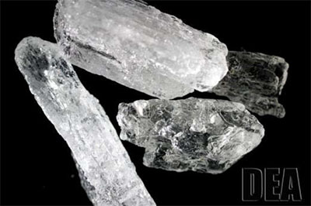
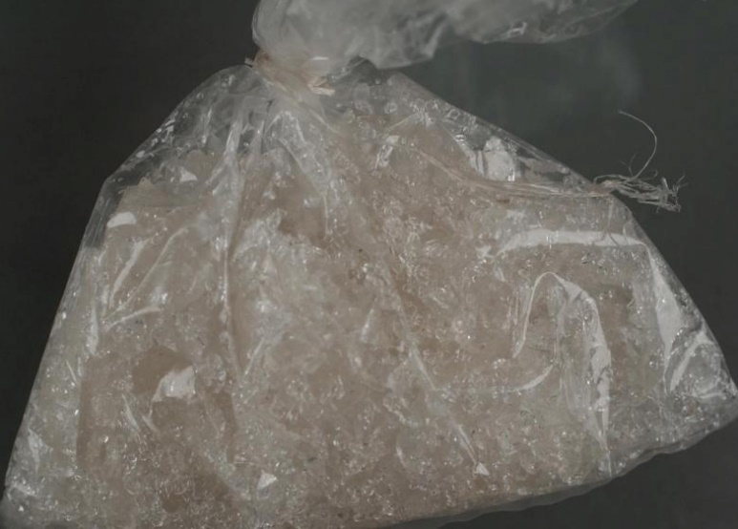
What Meth Looks Like
Crystal Meth
Notes:
Methamphetamine can come in many different forms. The most common form being crystal methamphetamine which looks like glass fragments or shiny, bluish-white rocks.

Slide 5
How Meth is Used
Snorted
Smoked
Injected
Notes:
Typically, individuals smoke, snort, or inject methamphetamine.

Slide 6
How big is the problem?
Notes:
Now that we have a better understanding of what meth is, let’s talk about why it is such a concern for Arizona communities.

Slide 7
Meth 2.0 | The New Meth
More deadly
More dangerous
More available
More pure
Notes:
Meth has been around for a long time. Anyone that was in Arizona in the early 2000’s might remember the impact from methamphetamine made in home labs.
Meth 2.0 is the nickname for today’s methamphetamine that is even stronger and cheaper.
Today’s meth is more pure. CLICK
More available. CLICK
More dangerous. CLICK
And more deadly. CLICK
Due to increased methamphetamine production in Mexico and declining costs, Arizona is seeing a devastating increase of people who sell and people who use methamphetamine in their communities.

Slide 8
The New Meth = Increased Deaths
"These findings are another indication that the overdose crisis in this country continues to evolve, and our public health response must adjust to meet
this challenge." Nora D. Volkow, M.D.,
Director of the National Institute on Drug Abuse,
National Institutes of Health
Notes:
While much attention is focused on the opioid crisis, a methamphetamine crisis has been quietly, but actively, gaining steam.
The National Institutes of Health has found there was a 5-fold increase in the number of deaths from methamphetamine over the past 8 years.
Methamphetamine overdose deaths rise sharply nationwide | National Institute on Drug Abuse (NIDA)
From 2012 through 2018, the age-adjusted rate of drug overdose deaths involving cocaine more than tripled, and the rate of deaths involving psychostimulants with abuse potential increased nearly 5-fold. https://www.cdc.gov/nchs/data/databriefs/db356-h.pdf
CLICK Quote source: https://www.upi.com/Health_News/2021/01/20/US-sees-5-fold-increase-in-methamphetamine-overdose-deaths/8061611153807/

Slide 9
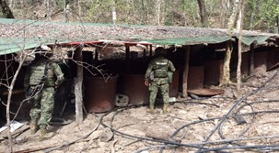
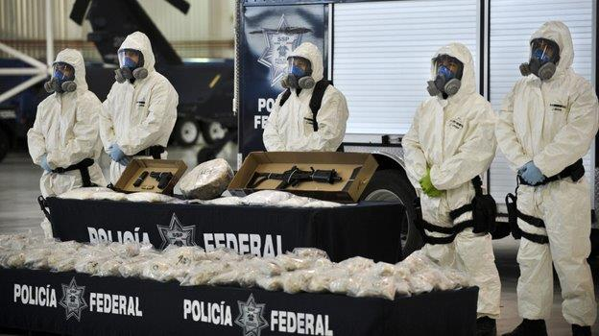
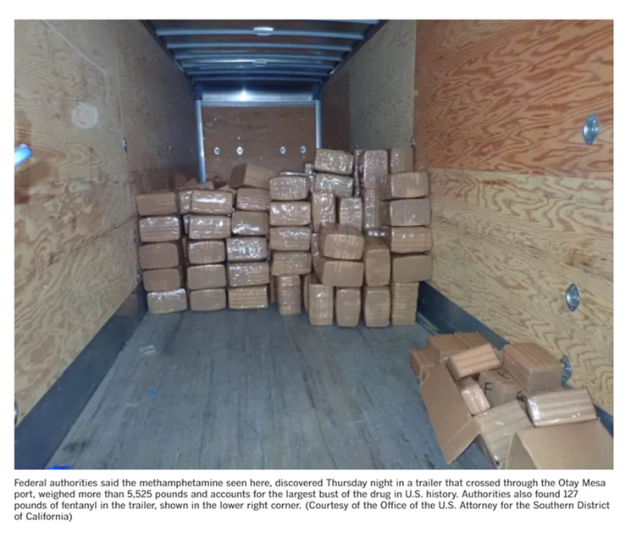
The New Meth = More Available
Photos: DEA
Notes:
Today’s Methamphetamine is produced, for the most part, on an industrial scale in Mexico. Oftentimes, these operations are called Super Labs.
The Southwest Border remains the main entry point for the majority of methamphetamine entering the United States.
The top photos are from the Drug Enforcement Administration’s Phoenix Division’s investigation of an industrial scale meth lab in Mexico.
The lower right photo is from August of 2021 showing what U.S. Customs and Border Protection officials called the largest methamphetamine drug-smuggling seizure along the southwest border to date. There was more than 2 tons of meth found.
They also found 127 pounds of fentanyl powder. (shown in the photo in the lower right corner)
CBP Officers Seize 2.8 Tons of Methamphetamine and Fentanyl at the Otay Mesa Commercial Facility | U.S. Customs and Border Protection

Slide 10
#2 Drug Threat in Arizona
247% increase in 5 years
(U/LES) Methamphetamine Seizures in Kilograms Arizona FY 2016- FY 2020
Source: EPIC NSS, as of August 17, 2021
Notes:
In 2020, meth was the #2 drug threat in Arizona - Second only to Fentanyl. (source: AZHIDTA, Drug Threat Assessment).
This graph shows the increase in the amount of methamphetamine seized by law enforcement in Arizona.
(CLICK) Federal, state, and local law enforcement saw a 247% increase in methamphetamine seizures over the past 5 years.

Slide 11
The New Meth = More Potent
97%
Notes:
The meth today CLICK has been found to have purity levels of 97%

Slide 12
The New Meth = Cheaper Prices
2015 - $350 per ounce
2019 - $140 per ounce
Photo credit: © Can Stock Photo / Tribalium
Notes:
Because meth is being mass produced in labs, the price of meth has continued to decline the last several years.
Street Value: Phoenix retail price decreased 58%, (CLICK) from an average of $350 per ounce in 2015 to $140 per ounce in 2019.

Slide 13
Troubling Trend
New ways people are now using meth
Photo credit: © Can Stock Photo / photopips
Notes:
Something that is new today is that people are eating or ingesting large quantities of meth.
Traditionally, individuals using meth would smoke, snort or inject the powder that had been dissolved in water or alcohol. With the increased availability and lower prices individuals are eating spoons full of powder meth increasing the risk of death.

Slide 14
Meth Laced with Fentanyl
Notes:
Methamphetamine is now being mixed with the dangerous drug fentanyl.
PSA on Fentanyl mixed with Meth - https://youtu.be/EFgn2GQVFbE

Slide 15
Health Consequences of Using Meth
Long term effects include:
Damage to the heart and brain
Anxiety
Confusion
Insomnia
Mood disturbances
Violent behavior
Severe Dental Problems
Weight Loss
Short-term effects include:
Increased wakefulness and physical activity
Decreased appetite
Faster breathing
Rapid and/or irregular heartbeat
Increased blood pressure and body temperature
Skin sores from intense itching
Memory Problems
Paranoia
Notes:
Methamphetamine use is linked to a range of serious health risks.
Meth overdoses can cause a stroke, heart attack and seizures. Even if the overdose is not fatal, the health consequences are significant.
Notes: (Source NIDA, NIH)
How does methamphetamine affect the brain?
Methamphetamine increases the amount of the natural chemical dopamine in the brain. Dopamine is involved in body movement, motivation, and reinforcement of rewarding behaviors. The drug’s ability to rapidly release high levels of dopamine in reward areas of the brain strongly reinforces drug-taking behavior, making the user want to repeat the experience.
Short-Term Effects
Taking even small amounts of methamphetamine can result in many of the same health effects as those of other stimulants, such as cocaine or amphetamines. These include:
increased wakefulness and physical activity decreased appetite
faster breathing
rapid and/or irregular heartbeat
increased blood pressure and body temperature
Long-term methamphetamine use has many other negative consequences, including:
extreme weight loss addiction
severe dental problems ("meth mouth")
intense itching, leading to skin sores from scratching anxiety
changes in brain structure and function confusion
]
Because the effect from the drug both starts and fades quickly, people often take repeated doses in a "binge and crash" pattern. In some cases, people take methamphetamine in a form of binging known as a "run," giving up food and sleep while continuing to take the drug every few hours for up to several days.
In addition to risking becoming addicted to methamphetamine, people who use methamphetamine long-term may experience a range of negative health outcomes, including damage to the heart and brain, anxiety, confusion, insomnia, mood disturbances, and violent behavior.⁵ In recent years, methamphetamine-involved overdoses have been increasing in the United States⁶ across many demographic groups.

Slide 16
What You Can Do
Notes:
Now that we have a better understanding of Methamphetamine, let’s look at the tools and resources we can use to respond.

Slide 17
Prevention
Screening & Intervention
Find Help
Healthy choices
Identify those in need
Treatment works
No drug use
Take action
Recovery is possible
Notes:
There is no single, simple answer, to the question what can you do, but there are solutions available that we can implement …
Through prevention - we can encourage our kids to make healthy choices and not engage in substance use – even preventing underage drinking, marijuana and tobacco use can help lower the chances they will use meth later in life.
Through Screening by identifying people struggling with substance use or mental health concerns and taking action early – The earlier the better. Doctors and school nurses can perform these screens.
And through effective treatment and continuing care – Treatment does work and recovery is possible for all substance use disorders.

Slide 18
Early Action Helps Later in Life
Prevent early use of alcohol, tobacco and marijuana
Talk with children early and often
Healthy choices
Dangers of underage drinking, tobacco and marijuana use
Healthy Rules and Consequences (Curfew, Screen Time, Online)
Screen and treat for depression, anxiety and other mental health conditions
Promote School Success
Goodness Grows
Notes:
While there is no 100% guarantee that a child won’t use substances, there are steps and actions that parents, and caregivers can take when children are young to help reduce the chances that they will use methamphetamine later in life.
Some of those steps include:
Talking with your children. Kids who say they’ve learned a lot about the risks of drugs and alcohol from their parents are up to 50% less likely to use those substances. Today it’s important to talk with children at all developmental stages regarding healthy living, healthy choices and also the dangers that substance use can cause to the child and the family. Establish clear expectations of no use with your children. We know that one of the best ways to prevent methamphetamine use is to prevent early tobacco, alcohol and marijuana use.
Setting healthy rules, establishing and applying consequences when necessary. Examples include setting a curfew, checking in when a child is out with friends via a text or call, limiting screen time and monitoring what is happening on apps they use.
Treating and screening for depression and anxiety. Untreated mental health conditions can be a predictor for substance use.
Also, things like encouraging reading, promoting school success and getting help for students struggling in school can make a big difference. (don’t be embarrassed)
Lastly, little things like noticing when your child does something good, helpful or kind and praising them for it. Positive reinforcement can go along way with our kids.

Slide 19
Notes:
But what do we do when someone we love is using methamphetamine. The most important message for us to convey is that there is always hope. Treatment and Support are Available.
(Play video)
Video on Free from Meth - https://www.youtube.com/watch?v=nY1dLBVEULM

Slide 20
Intervention and Treatment
Addiction (Substance Use Disorder) is a disease, and like other diseases, it can be treated.
Myths
Realities
She can stop if she really wants to
People need to hit “rock bottom”
Treatment won’t work
Meth addiction is hopeless and untreatable
People need help with addiction
Acting sooner is better
Treatment can help – it works for many
Meth addiction is challenging and treatable
Research shows there are several approaches showing positive results in treating stimulant use disorders.
Notes:
Understanding that addiction/substance use disorder is a disease is key to successfully overcoming some of the barriers to seeking treatment.
There are a lot of misunderstandings and misperceptions about treatment for substance use.
Here are some of those – we show them as myths and realities.
Part of the nature of addiction is lack of control – so people who may want to stop can’t do so without help.
Current research shows that early intervention yields better results than waiting until the addiction is deep – one does not have to hit “rock bottom” to be ready for treatment. If we wait until someone hits rock bottom, that can be too late if the person overdoses and dies.
There is ample evidence that treatment works. The key is to find the right program for each individual’s needs.
Some people believe meth is not treatable. This is not true. It is challenging, but it clearly is treatable. Another thing to note is that the experts are finding good success rates with several treatment approaches for meth. Generally, the longer the duration and the more comprehensive the program, the better the results are.

Slide 21
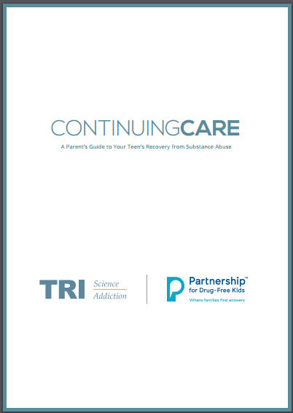
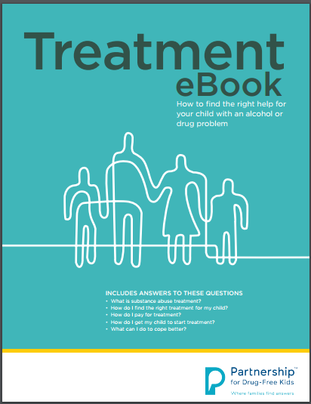
Seek treatment options
Ask questions
Support recovery
Self-care
Notes:
Three important things to do when you are seeking treatment for a loved one are:
To ask questions. Not all treatment providers are created equal and different programs have different approaches. The Partnership to End Addiction has developed a Treatment e-book that identifies questions to ask of a provider.
Substance use disorders are chronic and recurring. It is important to provide Continuing Care and another e-book from the Partnership provides information on that topic.
Finally, it is important for caregivers to take care of themselves. Helping a person struggling with a substance use disorder can be exhausting and overwhelming.

Slide 22
Questions?
Contact information
Notes:
Add resources and websites we’ve created
SAMSHA meth website and phone number

